Slide 1
Future Simple Will-Future

Slide 2
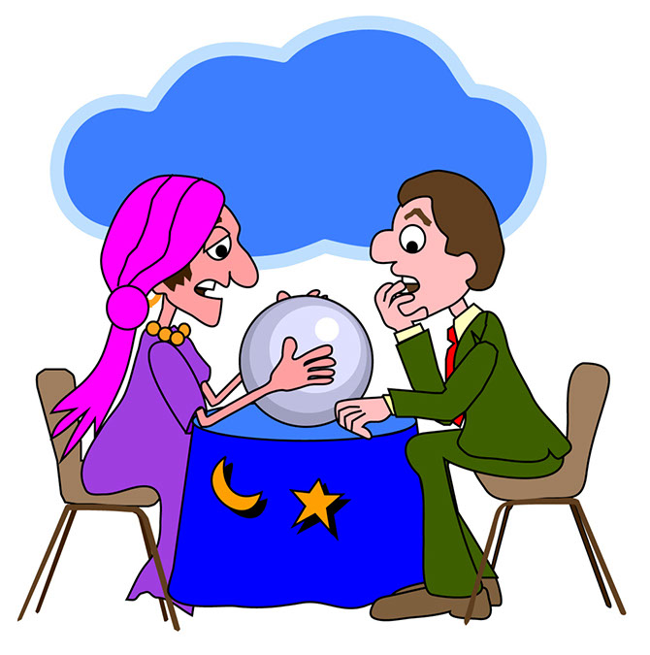
You won‘t be rich.
You will not be rich.
You will live a long and happy life.
You will have two children and a dog.
You won‘t get married.
You will not get married.

Slide 3
Will I be healthy?
Will I fall in love?
Will we live on Mars?
Will I get a better job?

Slide 4
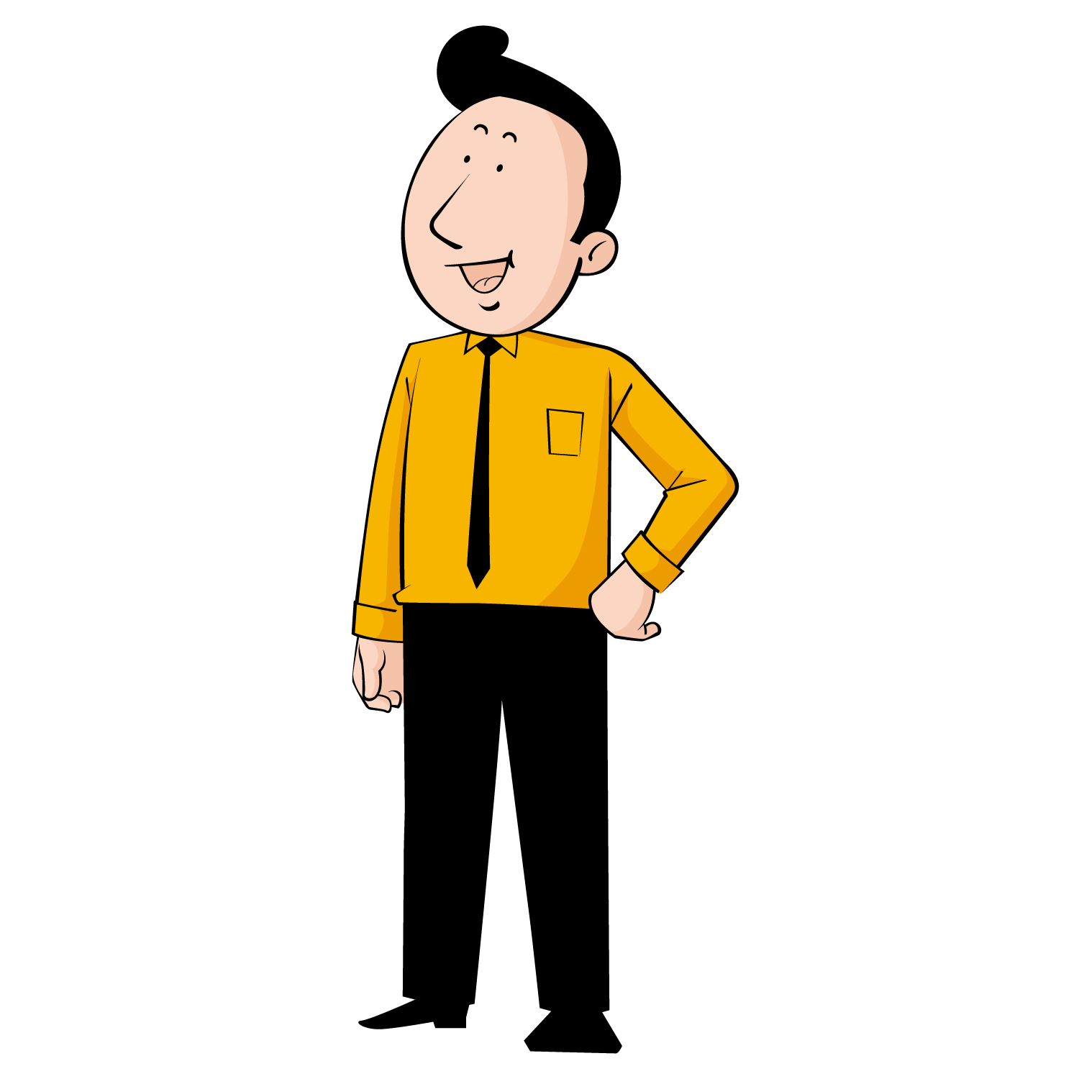
Johnny, will you set the table?
Sure, Dad, I will do it in five minutes!

Slide 5
Future Simple
To talk about predictions and promises in the future, we can use the future simple.
Signal words:
tomorrow, next week,
next weekend,
a few days, weeks, years later

Slide 6
Future Simple - affirmative
I
You
He/She/It
We
You
They
will
stay
at home.
´ll
Subject + ´ll/will + infinitive without to

Slide 7
Future Simple - negative
I
You
He/She/It
We
You
They
will not
travel
this summer.
won‘t
Subject + won‘t/will not + infinitive without to

Slide 8
Future Simple - Questions
Will
I
you
he/she/it
we
you
they
go
to school in June?
When
will
go
to school ?
will + subject + infinitive without to
Question word + will + subject + infinitive without to

Slide 9
Exercise: Ask for the underlined word(s)
I will go shopping next Monday.
When
will
you
go
shopping?
I will go shopping next Monday.
What
will
you
do
next Monday?
Billie Eilish won‘t play any concerts this summer.
Who
won‘t
play
any concerts this summer?

